Slide 1

Error Bounds for Approximations with Deep ReLU Networks
A Constructive Proof of Expressivity (Yarotsky, 2017)

Slide 2

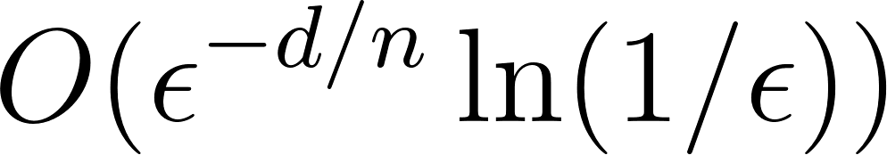
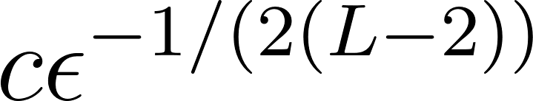
The Core Argument
Deep ReLU networks are fundamentally more efficient at approximating smooth functions than shallow networks.
Deep Network Upper Bound:
Shallow Network Lower Bound:
The paper proves this using an exact, layer-by-layer mathematical construction.
（For the fixed depth L）

Slide 3

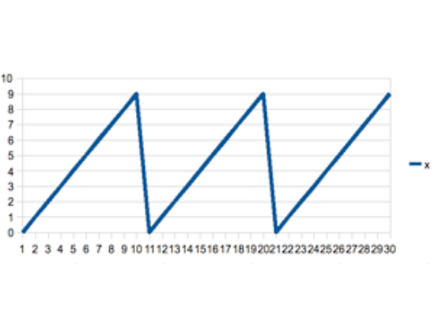



Step 1: The Sawtooth Function
•
The foundational building block is a simple, piecewise "hat" function.
•
Composing this function with itself m times generates a "sawtooth" wave.
Key Takeaway: * A depth of O(s) generates exactly 2^(s-1) linear "hats".
Depth yields an exponential explosion of linear segments without expanding width.

Slide 4






Step 2: Approximating Squaring
Interpolation
Refinement
Logarithmic Cost
The function f(x) = x² is first approximated by piecewise linear interpolation on a very coarse grid.
The error between a coarse and fine interpolation is exactly proportional to the previously defined sawtooth function.
By summing m scaled sawtooths, x² is ε-approximated using highly efficient depth and size O(ln(1/ε)).

Slide 5



Step 3: Approximate Multiplication
Algebraic Reduction
Network Complexity
Multiplication of two independent variables is elegantly reduced to addition and squaring via the classic identity:
Since exact addition is trivial for a standard ReLU node, and our approximate squaring requires only logarithmic depth.
We can construct a highly accurate 2D multiplier network with an overall logarithmic depth complexity.

Slide 6

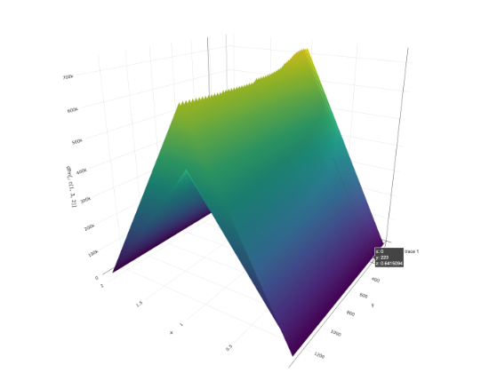
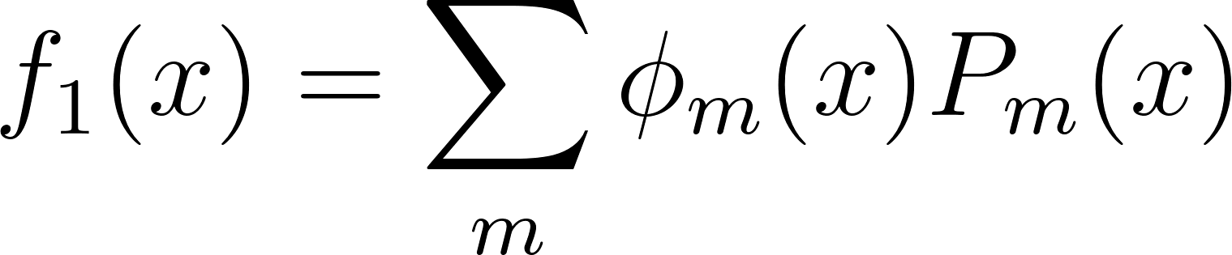
Step 4: Taylor & Partition of Unity
•
For a generic smooth function in a Sobolev space, the multi-dimensional domain is sliced into a fine grid.
•
Inside each grid cell, the function is approximated by a local Taylor polynomial.
•
A "Partition of Unity" (a set of specialized blending functions) stitches these local polynomials together smoothly.

Slide 7

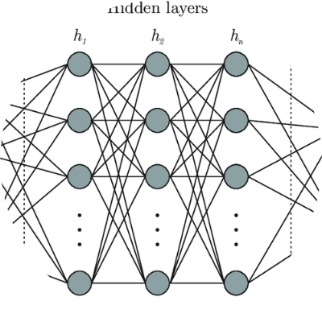


Step 5: Final Network Assembly
Chaining the Multipliers
Chaining the Multipliers: The final network computes local Taylor polynomials by chaining the logarithmic-depth approximate multipliers.
Partition of Unity Assembly: These local polynomials are seamlessly blended by Partition of Unity functions to construct the global continuous output.
Theorem 1 Result: Network Complexity Bounds
Required Depth:
Total Weights & Units:
(Depends on domain dimension d and function smoothness n)

Slide 8




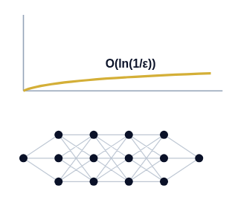
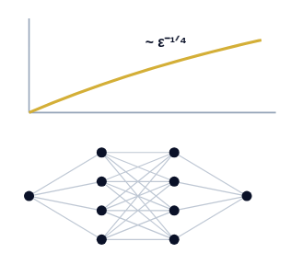
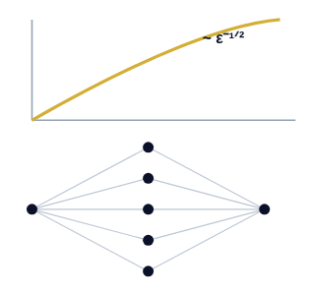
Deep vs. Shallow Complexity
Deep Networks
Shallow (Depth=4)
Shallow (Depth=3)
Unbounded Depth
Exactly 2 Hidden Layers
Exactly 1 Hidden Layer

Slide 9
Conclusion
The Expressive Power of Depth
Depth acts as a space-folding multiplier: By repeatedly composing the ReLU function (the "sawtooth" mechanism), deep networks generate an exponential number of linear regions with only logarithmic depth.
Deep is strictly more efficient than shallow: For sufficiently smooth functions, artificially constraining network depth forces a severe, provable polynomial explosion in the required network width.
The Curse of Dimensionality persists, but is mitigated: While depth drastically improves efficiency, the overall network size remains bounded by the input dimension d.

Slide 10
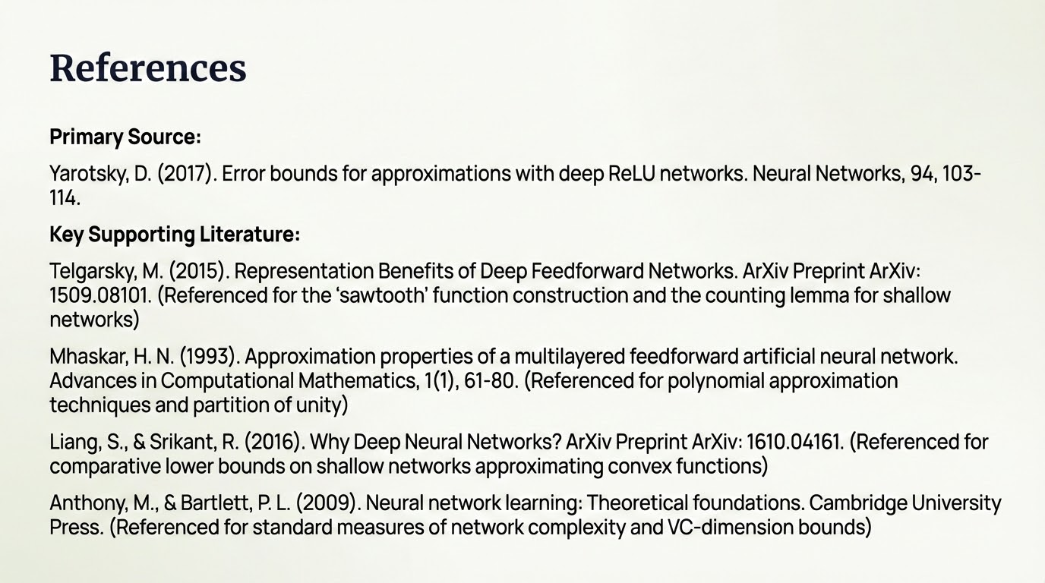

Slide 11
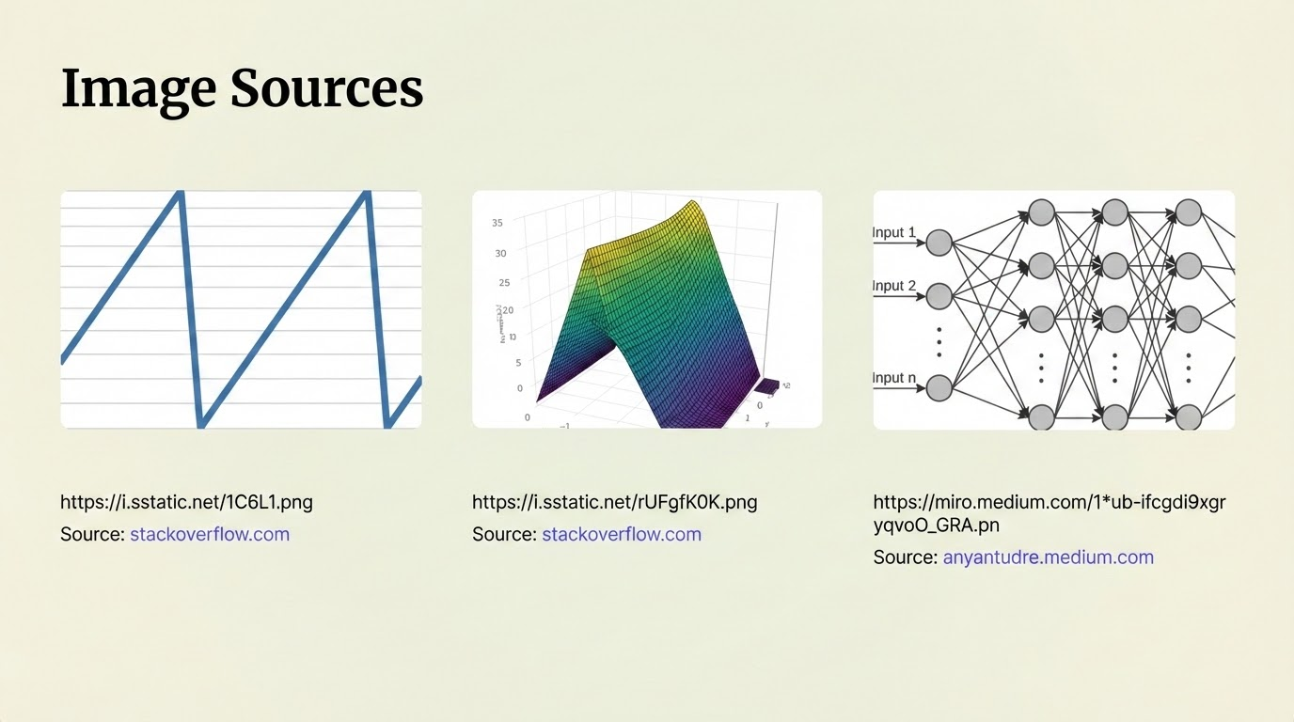

Slide 12


